Slide 1

Psychosomatic disorder
Diagnosis and therapy
Dr. Vid Velikić
Department of Psychiatry and Psychotherapeutic Medicine
IDM

Slide 2

What is a psychosomatic disorder?
Psychosomatic disorder is a psychological condition involving the occurrence of physical symptoms, usually lacking a medical explanation. People with this condition may have excessive thoughts, feelings or concerns about the symptoms — which affects their ability to function well

Slide 3
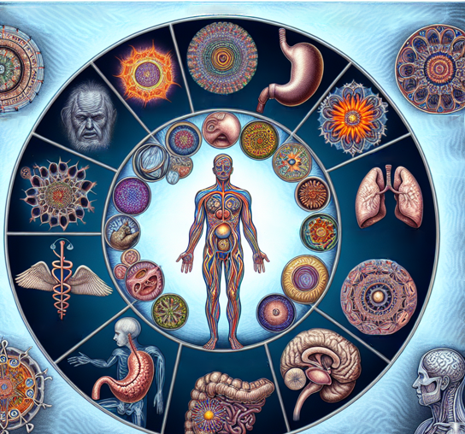
What are the 7 psychosomatic diseases?
Since Franz Alexander (1950) gave prominence to the Holy Seven Psychosomatic Diseases, the field of psychosomatic medicine has come a long way. While Alexander’s emphasis on essential hypertension, thyrotoxicosis, bronchial asthma, rheumatoid arthritis, peptic ulcer, ulcerative colitis, and neurodermatitis may have been inadvertent, it nevertheless established in the minds of several generations of physicians that these were the psychosomatic diseases, while implying that other diseases were not so or less so. Their designation as diseases in which psychological determinants could be identified implied that they could be treated by psychotherapy.

Slide 4

Causes of psychosomatic disorder:
Genetic and biological factors, such as an increased sensitivity to pain
Family influence, which may be genetic or environmental, or both
Personality trait of negativity, which can impact how you identify and perceive illness and bodily symptoms
Decreased awareness of or problems processing emotions, causing physical symptoms to become the focus rather than the emotional issues
Learned behavior — for example, the attention or other benefits gained from having an illness; or "pain behaviors" in response to symptoms, such as excessive avoidance of activity, which can increase your level of disability

Slide 5

Risk factors
Risk factors for somatic symptom disorder include:
Having anxiety or depression
Having a medical condition or recovering from one
Being at risk of developing a medical condition, such as having a strong family history of a disease
Experiencing stressful life events, trauma or violence
Having experienced past trauma, such as childhood sexual abuse
Having a lower level of education and socio-economic status

Slide 6

Complications
Somatic symptom disorder can be associated with:
Poor health
Problems functioning in daily life, including physical disability
Problems with relationships
Problems at work or unemployment
Other mental health disorders, such as anxiety, depression and personality disorders
Increased suicide risk related to depression
Financial problems due to excessive health care visits

Slide 7

Prevention
Little is known about how to prevent somatic symptom disorder. However, these recommendations may help.
If you have problems with anxiety or depression, seek professional help as soon as possible.
Learn to recognize when you're stressed and how this affects your body — and regularly practice stress management and relaxation techniques.
If you think you have somatic symptom disorder, get treatment early to help stop symptoms from getting worse and impairing your quality of life.
Stick with your treatment plan to help prevent relapses or worsening of symptoms.

Slide 8

Treatment of Psychosomatic Disorders
Cognitive Behavior Therapy (CBT) is often the treatment of choice for a psychosomatic disorder. This therapy helps patients learn new ways to cope with and solve their problems as they gain a deeper understanding of their condition or circumstances. Patients will also learn to set realistic life goals and identify and change behaviors or thoughts that have negative effects on their lives.

Slide 9

Interesting case
Current Complaints
Therapy at admission
Previous illnesses
Somatic analysis
Previous treatments
Social history
Family history
PPS
Findings
Diagnoses
Treatments

Slide 10

1. Current complaints
Comes to the 3rd informal admission at 06B station, Vienna General Hospital
Currently, whole-body pain (increase in frequency); Everyday life dominated by dealing with pain
By Pain Outpatient Clinic recommended reduction of opiate pain therapy
Perfectionism

Slide 11

2. Therapy on admission
Tramal 200 mg 1-0-0-0
Temgesic 0.4 mg 1-1-0-2
Seroquel XR 50 mg 0-0-1/2-1
Fluoxetine 40 mg 1-0-0-0
Mirtazapine 30 mg 0-0-0-1
Temesta 2.5 mg 0-0-0-1/2
Pantoloc 40 mg 1-0-0-0
Nebilan 5 mg 1/2-0-0-0
Transtec 35 μg patch at 4-day intervals

Slide 12

3. Previous illnesses
Pain since 2007 (first low back pain, then pain in the hands and forearms)
Various medication trials (analgesics, AD, benzo), as well as psychotherapy
2008 Death of mother and first depressive episode
15.12.2009 Suicide attempt with 2 boxes of Rohypnol
Followed by a 2-week stay in the OWS (1st psychiatric inpatient admission)
March and April 2010 Rotation on 06B
2016 – 2nd recording on 06B

Slide 13

4. Somatic analysis
At the age of 13 years traffic accident (hit by car- hit-and-run)
triple skull fracture, since then clear anisocoria left>re
S.p. Appendectomy; Curettage

Slide 14
5. Previous treatments
2007 Outpatient (Mrs. Dr. Danielczyk), adjustment to Cymbalta, Mexalen, Transtec patches
2008 – 2009 twice a week pszchotherapy
2009 OWS adjustment to Efectin and Lyrica and Transtec patches at 4-day intervals
2010- Rotation at the General Hospital
2016- General Hospital

Slide 15
6. Social analysis - Part I
Born on 18.11.1956 in Vienna
Pat.'s father passed away when she was 6 years old
Grew up to the age of 17 with her mother
5 siblings, one of the 5 brothers died in a moped accident
She attended elementary and secondary school in Vienna
Sales assistant at various companies
1978-2000 at Dorotheum, most recently as head saleswoman
In the course of restructuring - bullying

Slide 16
6. Social Analysis - Part II
Retraining as a nursing assistant
2004-2010 Sophienspital, then retirement
Married
No children

Slide 17
7. Family anamnesis
Grandfather (on his mother's side) had committed suicide

Slide 18
8. PPS
Patient awake, clear, oriented, concentration, memory grossly clinically inconspicuous, ductus coherent, goal-oriented, slightly slowed down, mood depressed, with negatively toned state of mind, low affect, affectability in both scale ranges reduced, strong somatization, social withdrawal, no specific fears, no compulsions, no panic attacks, no psychotic symptoms can be explored, no sleep disorders under medication with Temesta, no suicidal thoughts, none symptoms for acute danger to oneself or others at the time or exploration.

Slide 19
9. Findings
Laboratory: Cholesterol, total 262 μg/dL, otherwise inconspicuous
CMRT- no pathological clinical signs

Slide 20
10. The diagnosis
F45.4 Somatoform pain disorder
F33.1 Recurrent depressive disorder, present moderate episode

Slide 21
11. Treatment
Pregabalin 50 mg 1-0-0-0
Pregabalin 150 mg 0-0-0-1
Seroquel XR 50 mg 0-0-½-2
Fluoxetin 20 mg 2-0-0-0
Mirtazapin 30 mg ½-½-½-1
Psychotherapy (CBT)

Slide 22

ICD-10 F45.4 Persistent pain disorder
Listed under F45 somatoform disorders
A. At least six months of continuous, most days persistent, severe and distressing pain in a part of the body that cannot be adequately explained by evidence of a physiological process or physical disorder, and which is persistently the main focus of patients' attention.
B. Exclusion: The disorder does not occur during schizophrenia or a related disorder (F20-F29) or exclusively during a mood disorder (F30-F39), a somatization disorder (F45.0), an undifferentiated somatization disorder (F45.1) or a hypochondriac disorder (F45.2)

Slide 23

DSM V 307.80 Pain Disorder in Connection with Psychological Factors
Listed under Somatoform Disorders
Pain in one or more anatomical region(s) is at the forefront of the clinical picture and is of sufficient severity to warrant clinical attention.
Pain causes suffering or impairment in social, occupational, or other important functional areas in a clinically significant way.
Psychological factors are considered to play an important role in the onset, severity, exacerbation or maintenance of pain.
The symptom or failure is not intentionally created or faked (as in the case of the fake malfunction or simulation).
The pain cannot be better explained by an affective, anxiety or psychotic disorder and does not meet the criteria for dyspareunia.

Slide 24

DSM V 307.80 Pain Disorder in Connection with Psychological Factors
Psychological factors are considered to play the main role in the onset, severity, exacerbation or maintenance of pain. (If a medical disease factor is present, it doesn't play a major role in the onset, severity, exacerbation, or maintenance of pain.) This type of pain disorder is not diagnosed if the criteria of somatization disorder are also met.
Determine if:
  Acute: duration less than 6 months
  Chronic: duration more than 6 months
  Pain disorder associated with both psychological and medical disease factors

Slide 25

Thank you for your attention!

